Slide 1
EE 2361: Introduction to Microcontrollers
Peng Li
lipeng@umn.edu
07/22/2015

Slide 2
Topics
SPI

Slide 3
Standard SPI Master-Slave Communication
One Master & One Slave
Master
Device
Slave
Device
SDI
SDO
SDO
SDI
SCK
SCK
SS
SS
SDI: Serial Data Input
SDO: Serial Data Output
SCK: Shift Clock Input (for the slave device) or Output (for the master device)
SS: Active-Low Slave Select (or data frame sync pulse)
Question: what’s the major difference between the SPI master and slave device?

Slide 4
Standard SPI Master-Slave Communication
One Master & Multiple Slave
Master
Device
Slave
Device 1
SDI
SDO
SDO
SDI
SCK
SCK
SS1
SS1
SS2
Slave
Device 1
SDO
SDI
SCK
SS

Slide 5
Other Configurations
Three Pin Configuration
Master
Device
Slave
Device
SDI
SDO
SDO
SDI
SCK
SCK
SS
SS

Slide 6
SPI Input / Output Review
SS: Active-Low, Chip Select or Slave Select. When this signal goes low, the slave will listen for SPI clock and data signals.
SCK: Serial Clock This Controls when data is sent and when it is read.
SDO: Serial Data Output This signal carries the data sent out of the device.
SDI: Serial Data Input This signal carries the data sent into the device.

Slide 7
SPI Data Transfer Block Diagram
Shift Register
Shift Register
Page 148 of datasheet.

Slide 8
SPIxBUF Registers
SPIxBUF: this register is used to buffer data to be transmitted (SPIxTXB) and data that is received (SPIxRXB).
The SPIxBUF register is actually comprised of two separate registers: the Transmit Buffer, SPIxTXB, and the Receive Buffer, SPIxRXB.
If a user writes data to be transmitted to the SPIxBUF address, internally the data is written to the SPIxTXB register.
Similarly, when the user reads the received data from SPIxBUF, internally the data is read from the SPIxRXB register.

Slide 9
Status Registers
SPIEN: SPI module enable bit. 1 – Enable; 0 – Disable
SPIROV: Receive Overflow Flag bit. 1 – New data arrived, but CPU has not read previous data in the SPIxBUF register. 0 – No overflow.

Slide 10
Status Registers (cont.)
SPIxTBF: SPI Transmit Buffer Full Status Bit. (1 – Full; 0 – Empty) SPIxTBF is automatically set in hardware when SPIxBUF is written, and is automatically cleared in hardware when SPI transfers data from SPIxTXB to SPIxSR.
SPIxRBF: SPI Receive Buffer Status Bit. (1 – Full; 0 – Empty) SPIxRBF is automatically cleared in hardware when SPIxBUF is read, and is automatically set in hardware when SPI transfers data from SPIxSR to SPIxRXB.

Slide 11
Control Register
MODE16: word/byte communication selection bit. (1 – word, 16 bits; 0 – byte, 8 bits)
SMP: Data Input Sample Phase Bit (must be cleared when SPI is used in Slave Mode)
CKE: Clock Edge Select Bit
CKP: Clock Polarity Select Bit
MSTEN: Master Mode Enable Bit (1 – Master Mode; 0 – Slave Mode)

Slide 12
SMP, CKP, CKE
CKP | CKE | SCK Idle State | SCK edge for data transmission
0 | 0 | Low | Transfer data from idle clock state to active clock state (rising edge)
0 | 1 | Low | Transfer data from active clock state to idle clock state (falling edge)
1 | 0 | High | Transfer data from idle clock state to active clock state (falling edge)
1 | 1 | High | Transfer data from active clock state to idle clock state (rising edge)
One can choose to use the middle or the end of a bit time to sample the incoming data.
When the SMP bit of the SSPSTAT register is 1, incoming data is sampled at the end of the bit time. Otherwise, incoming data is sampled at the middle of a bit time.

Slide 13
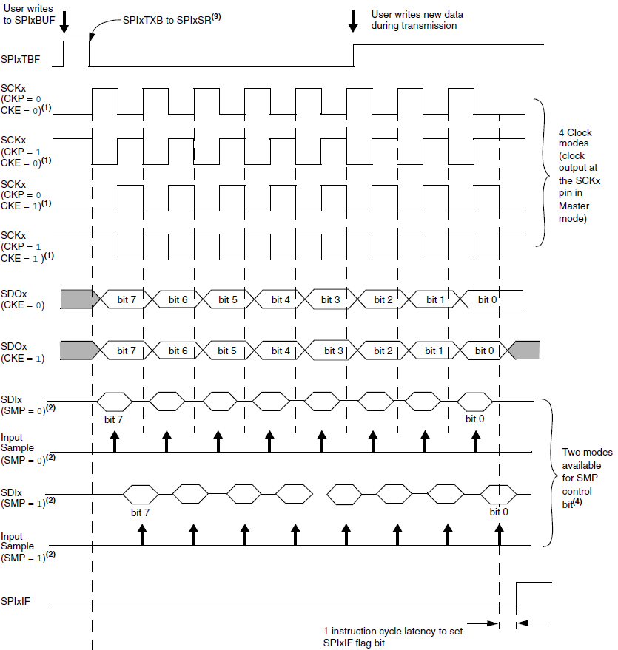

Slide 14
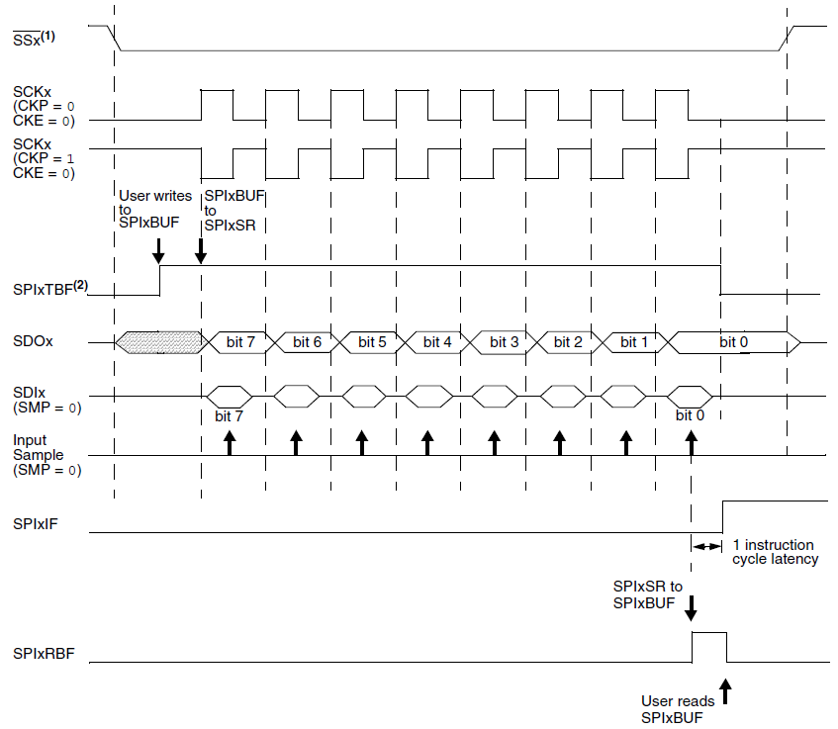

Slide 15
SPI Prescale Bits
Page 142 of datasheet.

Slide 16
Relationship Between Device and SPI Clock Speed
Exercise: SPI1CON1 is set to 0x013C. How many Tcy cycles does it take to transmit 3 bytes?

Slide 17
Setup SPI Module for the Standard Master Mode
Clear SPIxCON1, SPIxCON2, and SPIxSTAT registers.
Set MSTEN bit (SPIxCON1<5> = 1)
Select the clock modes (SMP, CKE, and CKP)
Select the clock speed (PPRE and SPRE).
Enable SPI operation by setting the SPIEN bit (SPIxSTAT<15> = 1)
Write the data to be transmitted to the SPIxBUF register. Transmission will start as soon as data is written to the SPIxBUF register.

Slide 18
Setup SPI Module for the Standard Slave Mode
Note that in this class, we won’t use PIC24 SPI in the slave mode.
Clear the SPIxBUF register.
Clear the SPIxIF bit in the corresponding IFSx register. If using SPI interrupt service routing, set the SPIxIE and SPIxIP bits in the corresponding IECx and IPCx register.
clear MSTEN bit (SPIxCON1<5> = 0)
Clear SMP bit (SPIxCON1<9> = 0)
If CKE bit is set, then the SSEN bit (SPIxCON1<7>) must be set to enable the SS pin.
Clear SPIROV bit (SPIxSTAT<6> = 0)
Enable SPI operation by setting the SPIEN bit (SPIxSTAT<15> = 1)

Slide 19
Exercise
Write an instruction sequence to configure the PIC24 SPI in the master mode to shift data on the rising edge. The SCK signal must be idle low. The data rate should be set to at least 2 Mbps assuming that f_{cy} is 16 MHz.

Slide 20
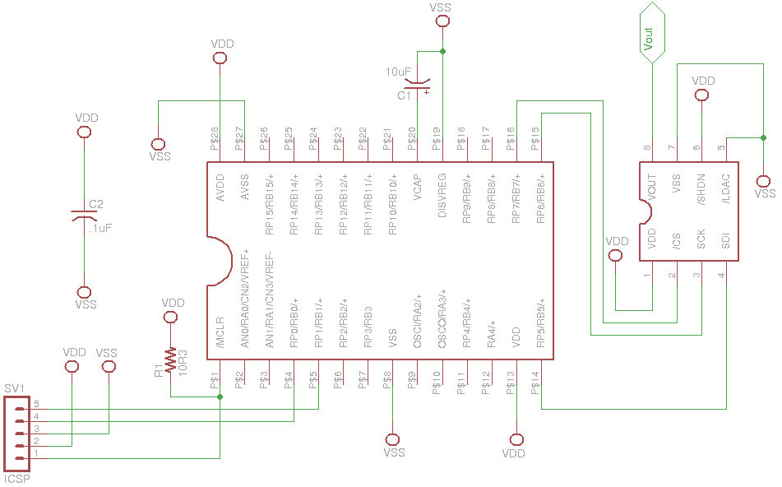
Example 1 – MCP4821 DAC (spi_pic24.c)

Slide 21
Example 1 – MCP4821 DAC
Pin Number | Symbol | Description
1 | VDD | Supply Voltage Input (2.7~5.5 V)
2 | CS | Chip Select Input (SPI Slave Enable)
3 | SCK | SPI Serial Clock Input
4 | SDI | SPI Serial Data Input
5 | LDAC | DAC Output Synchronization Input.
6 | SHDN | Hardware Shutdown Input.
7 | VSS | Ground Reference.
8 | Vout | DAC Analog Output

Slide 22
Example 1 – MCP4821 DAC
SPI Slave Module
Internal Reference Voltage for DAC
Page 2 of MCP4821 datasheet.

Slide 23
Example 1 – MCP4821 DAC
$V_{out}=\frac{2.048×D}{2^{12}}×G$
Gain Selection (G) | Voltage Granularity | Maximum Voltage
1 | 0.5mV | 2.0475V
2 | 1mV | 4.095V

Slide 24
Example 1 – MCP4821 DAC
Bit 15: 0 – write to DAC register. 1 – Ignore this command.
Bit 13 (GA): 1 – Gain selection for 1x 0 – Gain selection for 2x
Bit 11-0 12-bit DAC input data bits.
Page 22 of MCP4821 datasheet.

Slide 25
Example 2 – 74HC595
Describe how to use two 74HC595 to drive up to eight common-cathode seven-segment displays.

Slide 26
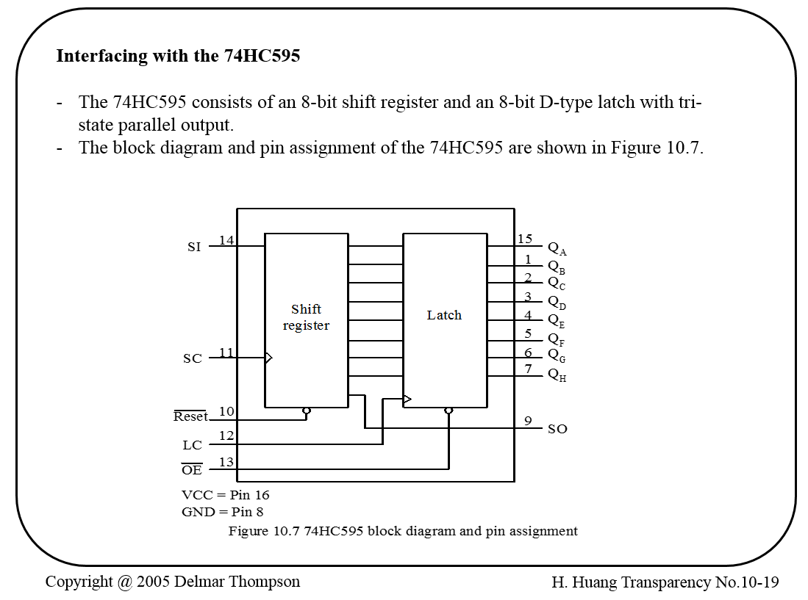
Example 2 – 74HC595

Slide 27
Example 2 – 74HC595
Operations of the 74HC595
The SI and SO pins are the serial input and serial output, respectively.
The data is shifted in on the rising edge of the SC signal.
The value of the shift register will be loaded into the output latch on the rising edge of the LC signal.
The 74HC595 can be used to add parallel output ports to the PIC24.

Slide 28
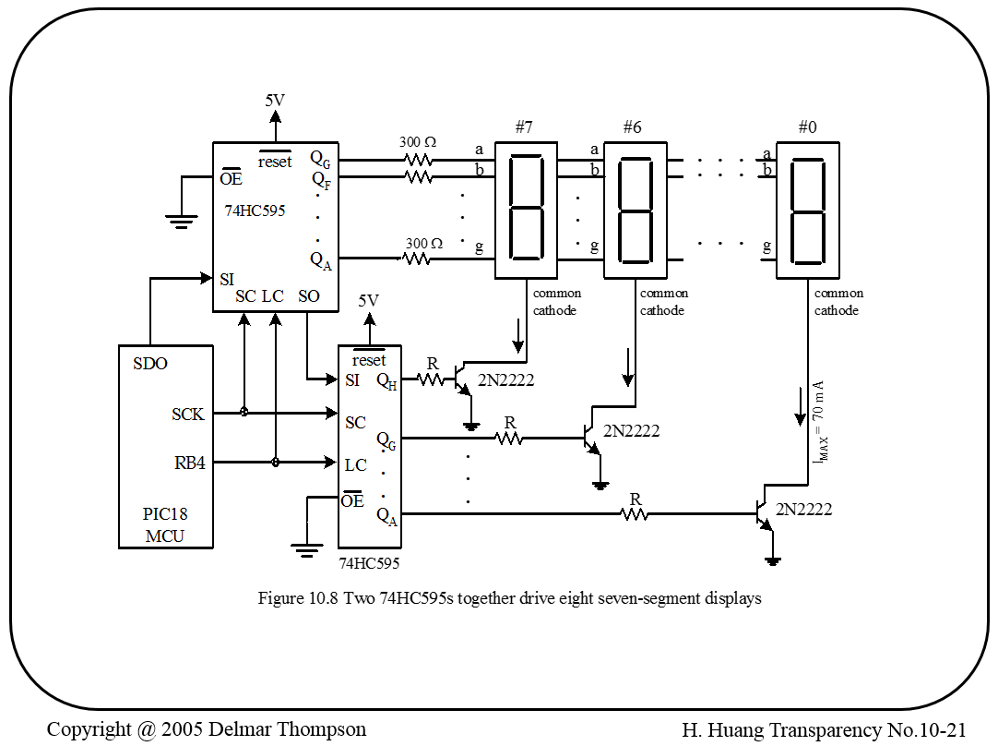
Example 2 – 74HC595
PIC24 MCU

Slide 29
Example 2 – 74HC595
We will need to develop two tables to control the segment patterns and display select signal.
Using time-multiplexing technique to enable each display every 1ms.
We will send a 16-bit word using the SPI. The most significant byte is for display selection, the least significant byte is for segment patterns.
Enable the latch after the data have been transferred to the shift register.

